Slide 1
Info 6079 Security Applications Lab
Student name: Gihan Shamike Liyanage
Student ID: 1142109
Date: 27/05/2023
Lab 4 Modules

Slide 2
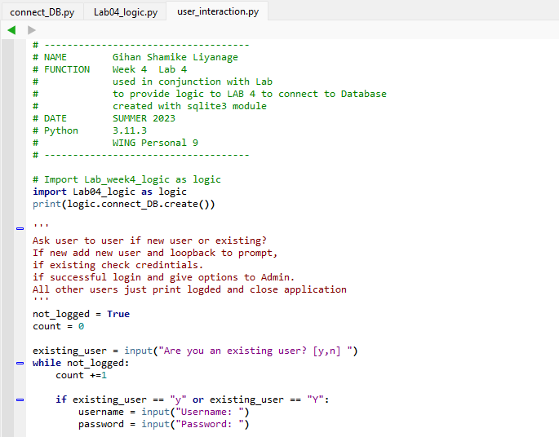
Screen Shot 1: Header Info to be added to .py file, add variable above

Slide 3
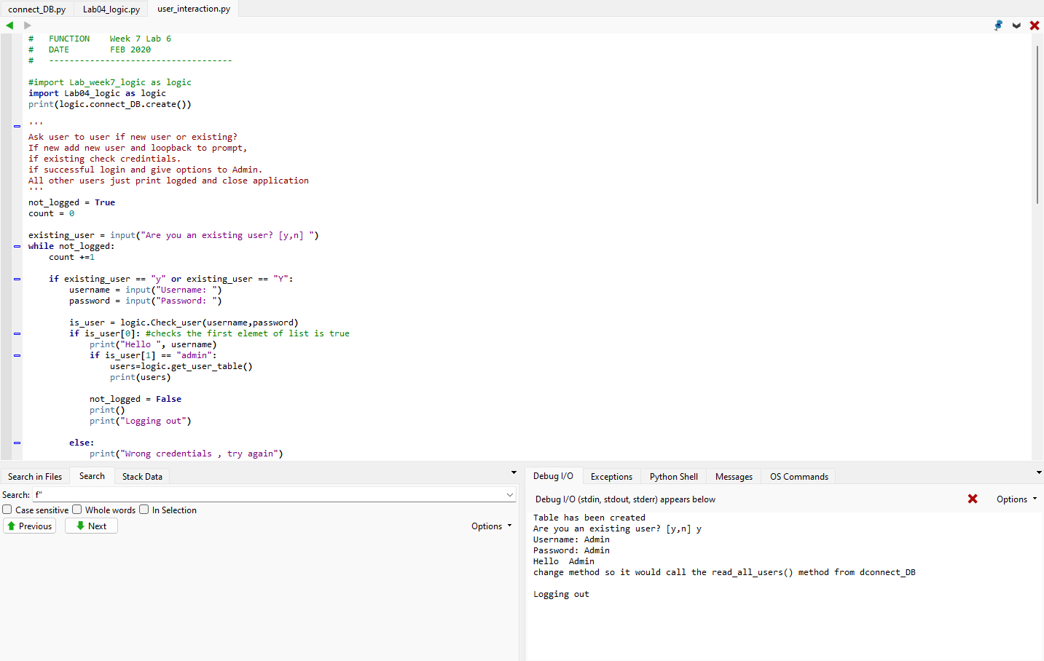
5) Screen Shot 2: Table exists, User added

Slide 4
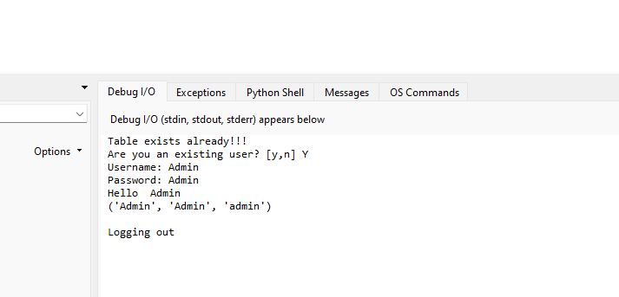
7a)Screen Shot 3: User interaction in Lab04_logic.py

Slide 5
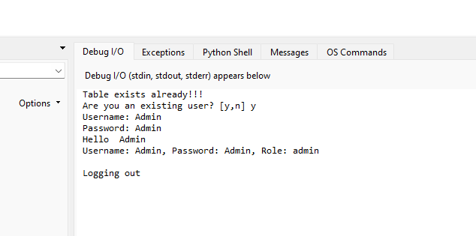
7b)Screen Shot 4: Table exists, show username, password

Slide 6
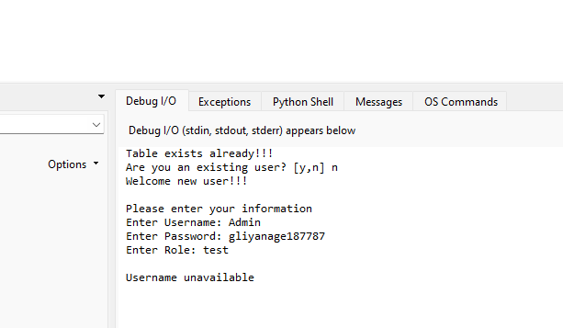
10)screen shot 5: Test Username duplication

Slide 7
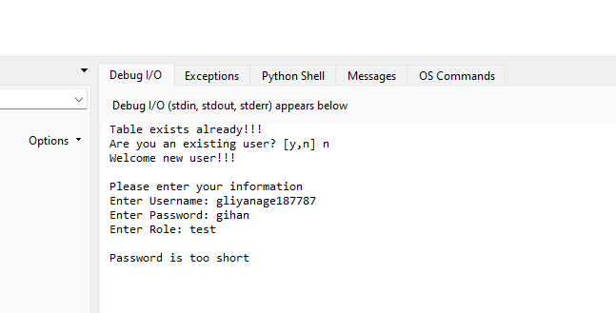
11)screen shot 6: Password too short

Slide 8
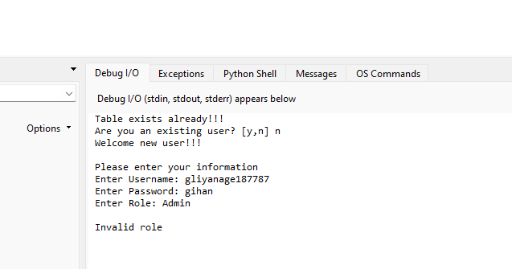
12)screen shot 7: Invalid Role

Slide 9
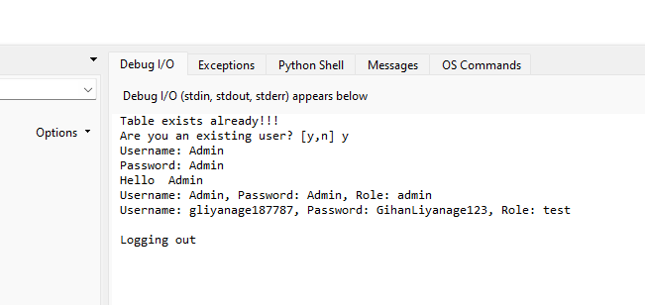
13)screen shot 8: Add new user, check password, username etc

Slide 10
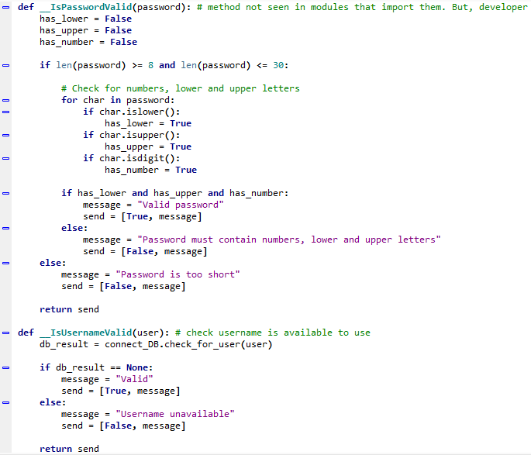
14)screen shot 9: Extra Code to check additional password rules

